Slide 2
Dave Olson
davetolson@gmail.com
510-703-2445

Slide 3
The Website
www.sixstyles.org

Slide 4
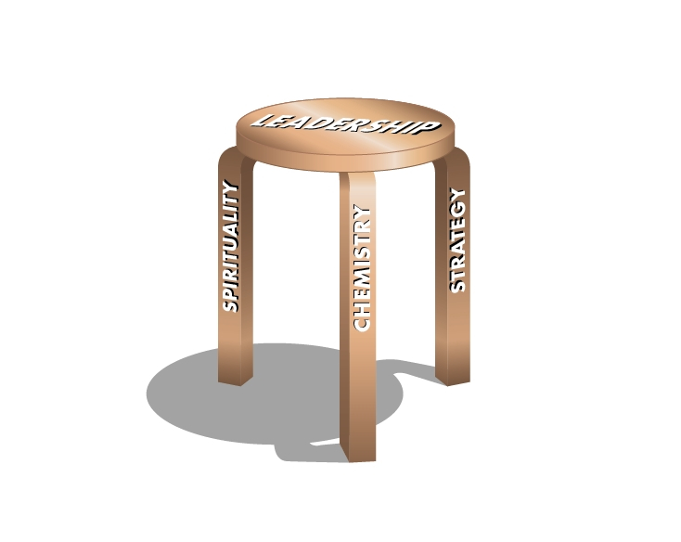
Who Are You?

Slide 5
"Why else were individuals created, but that God, loving all infinitely, should love each differently? And this difference, so far from impairing, floods with meaning the love of all blessed creatures for one another, the communion of the saints."

Slide 6
"If all experienced God in the same way and returned Him an identical worship, the song of the Church triumphant would have no symphony, it would be like an orchestra in which all the instruments played the same note. "

Slide 7
Aristotle has told us that a city is a unity of unlikes, and St. Paul that a body is a unity of different members. Heaven is a city, and a Body, because the blessed remain eternally different:

Slide 8
a society, because each has something to tell all the others - fresh and ever fresh news of the "My God" whom each finds in Him whom all praise as "Our God".
C. S. Lewis, The Problem of Pain, chapter nine, "Heaven"

Slide 9
What do you use to Serve God?

Slide 10
Your Gifts,
Your Passions,
Your Personality
and
Your Cultural Experiences.

Slide 11
Most Christians do not know what their best Gifts are.

Slide 12
Most Christians do not connect their Passions with their Gifts.

Slide 13
Most Christians do not understand that God works through your unique personality.

Slide 14
Most Christians do not understand that they will minister best in the place of their cultural experiences.

Slide 15
What was Your
Favorite
Car?

Slide 16
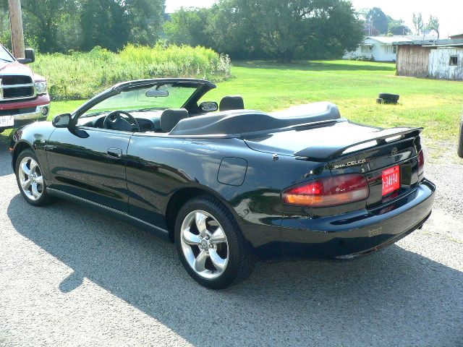

Slide 17
Your Gifts are the Vehicle you drive.
You serve God with your gifts.

Slide 18
Your Passion
Is the Gas in
your tank -
what motivates
the use of
your gifts.

Slide 19
Your Personality is how you drive your vehicle,
the unique you - created by God, but shaped by your family, experience
and culture.

Slide 20
Your Gifts are your vehicle.
Your Passion is the gas in the Tank.
Your Personality determines how you drive your vehicle.

Slide 21
Your Cultural Experiences . . .
Determine who you will be best at reaching (unless you have a missionary gift.)

Slide 22
Fruit . . .
Is What God longs to Produced in Us - When our Activities are Touched by the Holy Spirit as we Serve Jesus, Fruit is produced.

Slide 23
In the Kingdom of God, the standard of evaluation is:
Count the Fruit!

Slide 24
Definition Of a
Christian Leader

Slide 25
Definition
Christian leadership occurs when a person influences OTHER PEOPLE to move forward in fulfilling God’s will for their lives, their families, their churches, their communities and sometimes the entire world.

Slide 26
Write Down
INDIVIDUALS that you want to help move forward in fulfilling God’s will for their lives.

Slide 27
Also
their families,
your church,
your community
Even the whole world.

Slide 28
Every Christian
is Meant to be
both a
Servant
and a
Leader.

Slide 29
Tell Your Neighbor:
You were meant
to be both
a Servant
and
a Leader!

Slide 30
The Three Special Gifts and the Six Styles

Slide 31
The Three Legs

Slide 32
God has given every Christian
a Special Gift to Serve Him.

Slide 33
What Were the Most Important Words of Jesus?

Slide 34
The Great Commandment A
"Love The Lord Your God, with all your heart . . .
"

Slide 35
The Great Commandment B
"And your neighbor as yourself (with all your soul)."

Slide 36
The Great Commission
Therefore go and make disciples of all nations, baptizing them in the name of the Father and of the Son and of the Holy Spirit, and teaching them to obey everything I have commanded you (with all your mind)." (Matthew 28:19)

Slide 38
God made you good at one of these three Legs. Nobody had to teach you - God made you good at this.

Slide 39
Spirituality Fulfills the Great Commandment A
Chemistry Fulfills the Great Commandment B
Strategy Fulfills the Great Comission

Slide 40
Which Leg Are You Strongest In?

Slide 41
The Three Legs of the Leadership Stool
Spirituality People have a commitment to deep spiritual transformation that brings about the life-changing work of God in people.
"Love the Lord your God with all your heart, soul, mind, and strength."

Slide 42
The Three Legs of the Leadership Stool
Spirituality -
Chemistry people create an inviting relational atmosphere that creates joy and love in the culture of your church.
"And your neighbor as yourself."

Slide 43
The Three Legs of the Leadership Stool
Spirituality -
Chemistry -
Strategy People create a process of sequential actions that produce fruitful ministry through your church, in line with God-directed goals.
"Therefore go and make disciples of all nations."

Slide 44
Spirituality leaders love beauty, depth, integrity, creativity.

Slide 45
Chemistry leaders love goodness, relationship, fun,
and connection.

Slide 46
Strategy leaders love physical accomplishment, efficiency, organization and expansion.

Slide 47
God gives every Christian an overarching "ministry gift" - either Spirituality, Chemistry or Strategy.

Slide 48
God made you good at your strongest leg, giving you both gifts and passion in this area.

Slide 49
Which is Your Strongest Leg?

Slide 50
Love God
Love the World
Love People

Slide 51
Christ Centered
Missional
Healthy

Slide 52
Beauty
Truth
Goodness

Slide 53
Meaning
Productivity
Friendships

Slide 54
Heart
Mind
Soul

Slide 55
Spirituality | Chemistry | Strategy
Loving God | Loving People | Loving the World
Great Commandment A | Great Commandment B | Great Commission
Receive The Vision | Rally Around The Vision | Implement The Vision
Praying Together | Playing Together | Planning Together
Spirit | Soul | Mind
Higher Up | Deeper In | Further Out
Eyes Of Faith | Hearts Of Love | Hands To Work
Beauty | Goodness | Truth
Why? | Who? | How?
Surrender | Gather | Advance
Sanctuary | Fellowship Hall | Board Room
Past Orientation | Present Orientation | Future Orientation
Pulpit | Coffee Cup | Whiteboard
Christ | Community | Cause

Slide 56
Your Strongest
Leg is What You Serve God with.

Slide 57
Spirituality people use beauty, depth, integrity, creativity to help other people love God.

Slide 58
Chemistry people use goodness, relationship, fun,
and connection to show love to other people.

Slide 59
Strategy people use physical accomplishment, efficiency, organization and expansion to love the world, by fulfilling the mission of God in the world.

Slide 60
You Serve God with Your
Strongest Leg.

Slide 61
How does this give you clearer focus on how You Can Serve God?

Slide 62
But . . . There's More!!

Slide 63
But . . . You Lead with Your Style.
Your Style will give you much more specificity about how you God will produce much fruit through your Ministry.

Slide 64
The Six
STYLES

Slide 65
Los Seis Estilos
El Lider Sagrado
El Lider Relacional
El Lider Imaginativo
El Lider Inspirador
El Lider Misionale
El Lider Constructor

Slide 66
The Sacred Leader is gifted by God to connect spiritually with people, and encourage them to grow deeper with God, while bringing attention to the voice of the Holy Spirit.
The Relational Leader is gifted by God to connect emotionally with individuals, and inspire them as a group to follow Jesus and love each other.
Sacred Leader
Relational Leader
Strongest in
Spirituality
Strongest in
Chemistry
Complementary Styles
Imaginative Leader
Inspirational Leader
The Imaginative Leader is gifted by God to interact powerfully with an innovative vision from God, then lead people to step out in faith and live out that new way of being the people of God.
The Inspirational Leader is gifted by God to connect powerfully with a crowd, and motivate them to follow Jesus, by encouraging them to engage in the mission of God.
Complementary Styles
Complementary Styles
Mission Leader
Building Leader
The Mission Leader is gifted by God with spiritual vision to foresee what is needed in the immediate future. Mission Leaders call people to follow a deeper Gospel, while multiplying disciples, expanding ministries and starting new ventures.
The Building Leader is gifted by God to strategize for growth, enlist other leaders, and then together lead the way in enlarging the mission of God.
Strongest in
Strategy

Slide 67
Sacred
Leader

Slide 68
Sacred leaders are strongest in Spirituality, intermediate in Chemistry and weakest in Strategy.
Sacred Leaders have an amazing gift of helping people experience the depths of God himself.

Slide 69
Sacred Leader is spiritually sensitive. They encourage others to pay attention to the voice of the Holy Spirit, and to grow closer to God.
Sacred Leader love beauty and artistry.
Sacred leaders usually have the gift of teacher; intra-personal intelligence; and the Need to be Right and the Need for Affirmation.
The primary role of a Sacred leader lay is to be a God Focuser. They are gifted at deepening others.
Mary the sister of Martha, John the disciple and Isaiah are Biblical examples of the Sacred Leader.
Contemporary and historic examples are Howard Thurman, J. R. R. Tolkien, Dallas Willard, Ruth Graham Bell.

Slide 70
Imaginative
Leader

Slide 71
Imaginative leaders are strongest in Spirituality, intermediate in Strategy and weakest in Chemistry.
They have an amazing gift of engaging their culture by communicating Jesus in a fresh and creative way, that both attracts, yet challenges, their culture.

Slide 72
Another word to describe an Imaginative leader is “creative”
Imaginative leader love ingenuity and invention.
They use their spiritual creativity to synthesize new ideas and models, and then use strategy to implement their imaginative ideas.
Imaginative leaders leaders usually have the gift of a prophet; cultural intelligence; and the Need to be Right and the Need to Over-Innovate.
A primary role of an Imaginative lay leader is to be a Ministry Innovator.
Samuel, Daniel and John the Baptist are Biblical examples of Imaginative Leaders.
Contemporary and historic examples are Martin Luther King, Dietrich Bonhoeffer and C. S. Lewis

Slide 73
Relational
Leader

Slide 74
Relational leaders are strongest in Chemistry, intermediate in Spirituality and weakest in Strategy.
They have an amazing gift of helping people and groups experience love in a real and personal way.

Slide 75
• They are gifted by God to connect emotionally with individuals and inspire them as a group to follow Jesus and love each other.
• Another word to describe a Relational leader is “loving.” They naturally lead through their ability to create caring relationships with large numbers of people.
• Relational leaders usually have the gift of a pastor/shepherd; interpersonal intelligence; and the Need for Affirmation and the Need for Attention.
• For Lay Leaders, this style is called People Encourager.
• Barnabas, Esther and Timothy are Biblical examples of Relational Leaders.
• Efrem Smith, Max Lucado, Doug Coe and Lloyd John Ogilvie are contemporary examples.

Slide 76
Inspirational
Leader

Slide 77
Inspirational leaders are strongest in Chemistry, intermediate in Strategy and weakest in Spirituality.
They have an amazing gift of motivating both Christians and seekers to desire a stronger connection with Jesus and to positively change society.

Slide 78
• They are gifted by God to connect powerfully with a team or crowd, and motivate them to follow Jesus through engagement in the mission of God.
• Another word to describe an Inspirational leader is motivational. They lead through their ability to influence people, especially through public speaking.
• Inspirational Leaders excel at getting people to rally around a vision.
• Inspirational Leaders usually have an evangelism gift; Social intelligence; and the Need for Attention & the Need for Power.
Peter, Apollos and Elijah are Biblical examples of Inspirational Leaders.
Aimee Semple McPherson, Luis Palau and Billy Graham are historical and contemporary examples.

Slide 79
Building
Leader

Slide 80
Building leaders are strongest in Strategy, intermediate in Chemistry and weakest in Spirituality.
They have an amazing gift of bringing people together to achieve physical progress in organizing and expanding the kingdom of God on this earth.

Slide 81
• The Building leader is gifted by God to strategize for growth, enlist other leaders, and then together lead the way in enlarging the mission of God.
They are best described as being gifted at either organizing or growing entities. Some instinctively know how to create the right conditions and systems that produce numeric growth, so that more and more people come and join. Others are best at organizing and strengthening.
Building Leaders usually have the gift of an apostolist; they have Organizational Intelligence; and the Need for Power and the Need to Over-Work.
Deborah, Saul and Nehemiah are three Biblical examples of Building leaders.
Historic and contemporary examples are Mother Teresa, John Maxwell and Bill Hybels.

Slide 82
Mission
Leader

Slide 83
Mission leaders are strongest in Strategy, intermediate in Spirituality and weakest in Chemistry.
They have an amazing gift of helping people see what God could accomplish if they left their safety zone and stepped out in faith on a new venture.

Slide 84
• The Mission leader is gifted by God with spiritual vision to foresee and implement what is needed in the immediate future, by calling people to follow a deeper Gospel while multiplying disciples, expanding ministries and starting new ventures.
• Another word to describe Mission leaders is multipliers. Their best fruitfulness comes through reproducing new leaders, new ministries and new churches.
• Many Mission leaders have the gift of an apostle; they also have Strategic Intelligence; and the Need to Over-Work and the Need to Over-Innovate.
Moses, Joshua and Paul are Biblical examples of Mission leaders.
Historic and contemporary examples are John Wesley, Franklin Graham, Henrietta Mears.

Slide 85
Deeper into the
Six Styles

Slide 86
Style
Discovery 1
=
Ephesians 4:11

Slide 87
The Six Styles and Ephesians 4:11 Gifts
Teacher
Pastor /
Shepherd
Sacred Leader
Relational Leader
Prophet
Imaginative Leader
Inspirational Leader
Evangelist
Mission Leader
Building Leader
Apostle
Apostelist

Slide 88
Style
Discovery 2
=
Your Special Intelligence

Slide 89
The Six Intelligences of Christian Leaders
Intrapersonal
Intelligence
Interpersonal
Intelligence
Sacred Leader
Relational Leader
Cultural
Intelligence
Imaginative Leader
Inspirational Leader
Social
Intelligence
Mission Leader
Building Leader
Strategic
Intelligence
Organizational
Intelligence

Slide 90
Style
Discovery 3
=
Your Deep Needs

Slide 91
The Six Hidden Needs of Christian Leaders
Need for affirmation
Need to be right
Sacred Leader
Relational Leader
Need for attention
Need for affirmation
Need to be right
Need to over-innovate
Imaginative Leader
Inspirational Leader
Need for power
Need for attention
Mission Leader
Building Leader
Need to over-innovate
Need to over-work
Need to over-work
Need for power

Slide 92
Style
Discovery 4
=
Your Church's Style

Slide 93
The Six Styles of Churches
Sacred Church
Relational Church
Imaginative Church
Inspirational Church
Mission Church
Building Church

Slide 94
Your Seven Most Likely Spiritual Gifts

Slide 95
Your Spiritual Gifts

Slide 96
There are different kinds of gifts . . . .
There are different kinds of service . . . . There are different kinds of working . . . . but in all of them and in everyone it is the same God at work.
1 Corinthians 12:4-6

Slide 97
God gives every Christian spiritual (and natural) gifts, that operate in harmony with your special ministry gift.

Slide 98
Sacred Leader
Craftsmanship
Discernment
Intercession
Knowledge
Mercy
Pastor
Teacher

Slide 99
Relational Leader
Encouragement
Evangelism
Giving
Hospitality
Mercy
Shepherd
Service

Slide 100
Inspirational Leader
Creative Communication
Encouragement
Evangelism
Faith
Giving
Hospitality
Leadership

Slide 101
Building Leader
Administration
Apostle
Creative Communication
Evangelism
Faith
Giving
Leadership

Slide 102
Mission Leader
Apostle
Creative Communication
Discernment
Faith
Knowledge
Leadership
Teaching

Slide 103
Imaginative Leader
Creative Communication
Discernment
Faith
Knowledge
Leadership
Prophecy
Teaching

Slide 104
Practicum

Slide 105
Practicum #1
I Can Get Better
God wants you to grow in Love for Himself, Love for People, Love for the World and Love of Wisdom.

Slide 106
Practicum #2
What is the Quickest Way to Grow as a Leader?
Strengthen Your Intermediate Leg
(Your Secret Weapon)

Slide 107
Practicum #3
How do you Strengthen your Weakest Leg?
Observe the Habits of Leaders You Know who are Strongest in your Weakest Leg, and Emulate Those Habits.

Slide 108
Practicum #4
Your Complementary Style
Becoming Equally Proficient at Your Complementary Style will Multiply Your Leadership Reach.

Slide 109
The Sacred Leader is gifted by God to connect spiritually with people, and encourage them to grow deeper with God, while bringing attention to the voice of the Holy Spirit.
The Relational Leader is gifted by God to connect emotionally with individuals, and inspire them as a group to follow Jesus and love each other.
Sacred Leader
Relational Leader
Strongest in
Spirituality
Strongest in
Chemistry
Complementary Styles
Imaginative Leader
Inspirational Leader
The Imaginative Leader is gifted by God to interact powerfully with an innovative vision from God, then lead people to step out in faith and live out that new way of being the people of God.
The Inspirational Leader is gifted by God to connect powerfully with a crowd, and motivate them to follow Jesus, by encouraging them to engage in the mission of God.
Complementary Styles
Complementary Styles
Mission Leader
Building Leader
The Mission Leader is gifted by God with spiritual vision to foresee what is needed in the immediate future. Mission Leaders call people to follow a deeper Gospel, while multiplying disciples, expanding ministries and starting new ventures.
The Building Leader is gifted by God to strategize for growth, enlist other leaders, and then together lead the way in enlarging the mission of God.
Strongest in
Strategy

Slide 110
Practicum #5 -
Where Does Leadership Development Occur Best?
Individual?
Team?
Crowd?

Slide 111
Leaders grow best in the context of a Team.
- for supporting information,
Please see Jesus Christ,
4b.c. - 29 a.d.

Slide 112
Practicum #6
Encouraging Others
No One Gets Enough Encouragement!
Don't Say a Vague Complement. Instead, let them know the gift you saw, and the specific situation where you saw it in action.
They will Love it, and Praise will go to God!

Slide 113
When each team member knows the Leadership Style of the other members, the team interconnection and productivity will increase significantly. They will count on each member's best gifts, while working around each other's weaknesses.

Slide 114
Session 4

Slide 115
A More Challenging Mission Field.
Young leaders are always our guides into how to prosper in the new world.

Slide 116
1. A More Challenging Mission Field.
2. A Lack of Clarity about the Power of the Word of God & the Gospel.

Slide 117
“Praise be to the God and Father of our Lord Jesus Christ, who has blessed us in the heavenly realms with every spiritual blessing in Christ. For he chose us in him before the creation of the world to be holy and blameless in his sight. In love he predestined us for adoption to sonship through Jesus Christ, in accordance with his pleasure and will— to the praise of his glorious grace, which he has freely given us in the One he loves."

Slide 118
“In him we have redemption through his blood, the forgiveness of sins, in accordance with the riches of God’s grace that he lavished on us. With all wisdom and understanding, he made known to us the mystery of his will according to his good pleasure, which he purposed in Christ, to be put into effect when the times reach their fulfillment—to bring unity to all things in heaven and on earth under Christ."
Ephesians 1:3-14

Slide 119
1. A More Challenging Mission Field.
2. A Lack of Clarity about the Power of the Word of God & the Gospel.
3. A Lack of Clarity about the Presence of the Trinity: Father, Son & Holy Spirit.

Slide 120
“As for you, you were dead in your transgressions and sins, in which you used to live when you followed the ways of this world and of the ruler of the kingdom of the air, the spirit who is now at work in those who are disobedient. All of us also lived among them at one time, gratifying the cravings of our flesh and following its desires and thoughts. Like the rest, we were by nature deserving of wrath."

Slide 121
“But because of his great love for us, God, who is rich in mercy, made us alive with Christ even when we were dead in transgressions—it is by grace you have been saved. And God raised us up with Christ and seated us with him in the heavenly realms in Christ Jesus, in order that in the coming ages he might show the incomparable riches of his grace, expressed in his kindness to us in Christ Jesus. For it is by grace you have been saved, through faith—and this is not from yourselves, it is the gift of God— not by works, so that no one can boast. For we are God’s handiwork, created in Christ Jesus to do good works, which God prepared in advance for us to do.” Ephesians 2:1-10

Slide 122
1. A More Challenging Mission Field.
2. A Lack of Clarity about the Power of the Word of God & the Gospel.
3. A Lack of Clarity about the Presence of the Trinity: Father, Son & Holy Spirit.
4. A Lack of Clarity about the Role of the People of God.

Slide 123
“For this reason I kneel before the Father, from whom every family in heaven and on earth derives its name. I pray that out of his glorious riches he may strengthen you with power through his Spirit in your inner being, so that Christ may dwell in your hearts through faith."

Slide 124
“I pray that you, being rooted and established in love, may have power, together with all the Lord’s holy people, to grasp how wide and long and high and deep is the love of Christ, and to know this love that surpasses knowledge—that you may be filled to the measure of all the fullness of God. Now to him who is able to do immeasurably more than all we ask or imagine, according to his power that is at work within us, to him be glory in the church and in Christ Jesus throughout all generations, for ever and ever! Amen.” Ephesians 3:14-21

Slide 125
"Why else were individuals created, but that God, loving all infinitely, should love each differently? And this difference, so far from impairing, floods with meaning the love of all blessed creatures for one another, the communion of the saints. If all experienced God in the same way and returned Him an identical worship, the song of the Church triumphant would have no symphony, it would be like an orchestra in which all the instruments played the same note. "

Slide 126
Dave Olson
davetolson@gmail.com
510-703-2445

Slide 127
The Website
www.sixstyles.org

